Slide 1
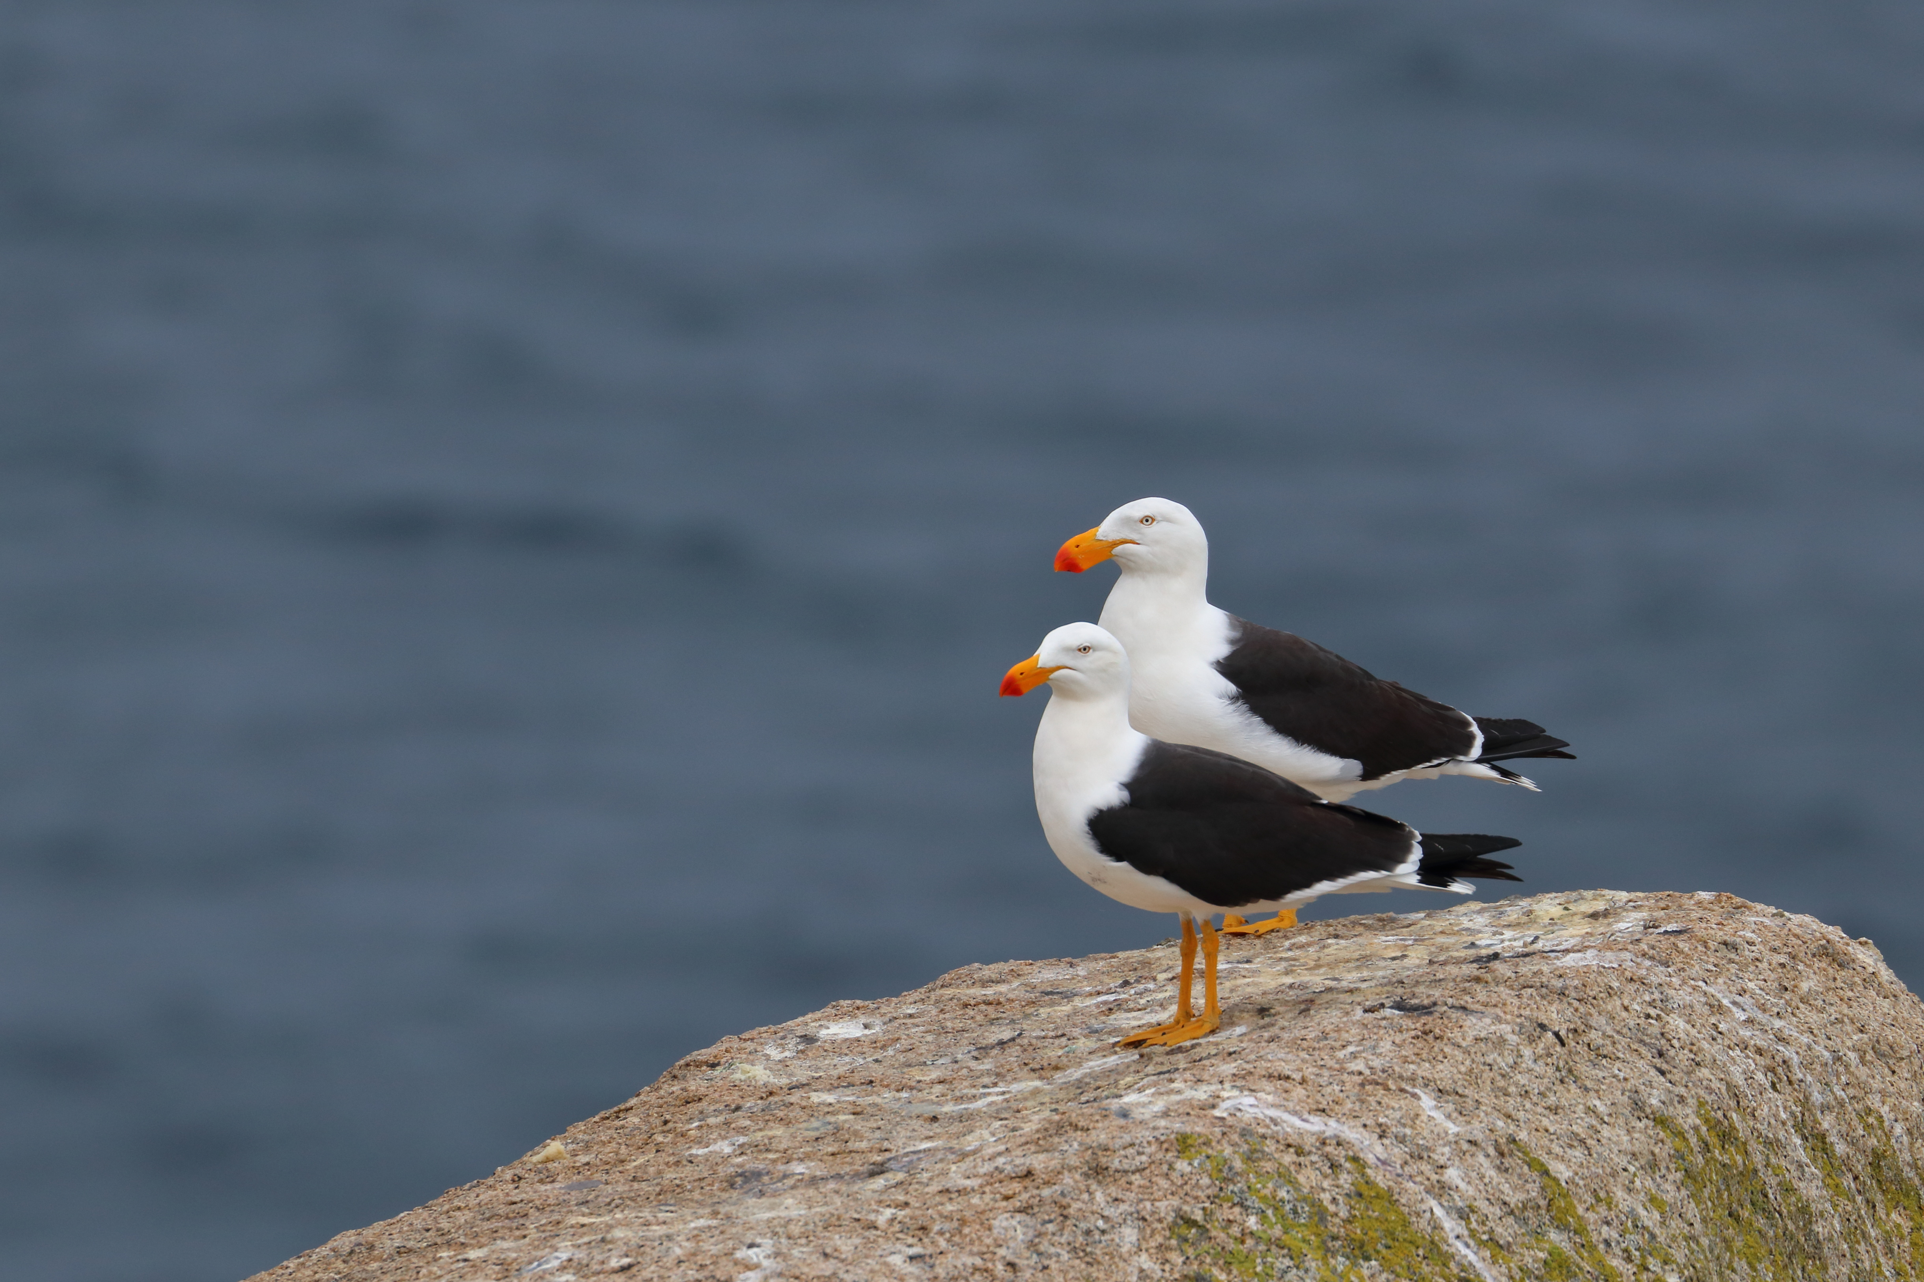
H5 bird flu – Communications pack
Information in this pack is correct as of: 6 August 2026

Slide 2
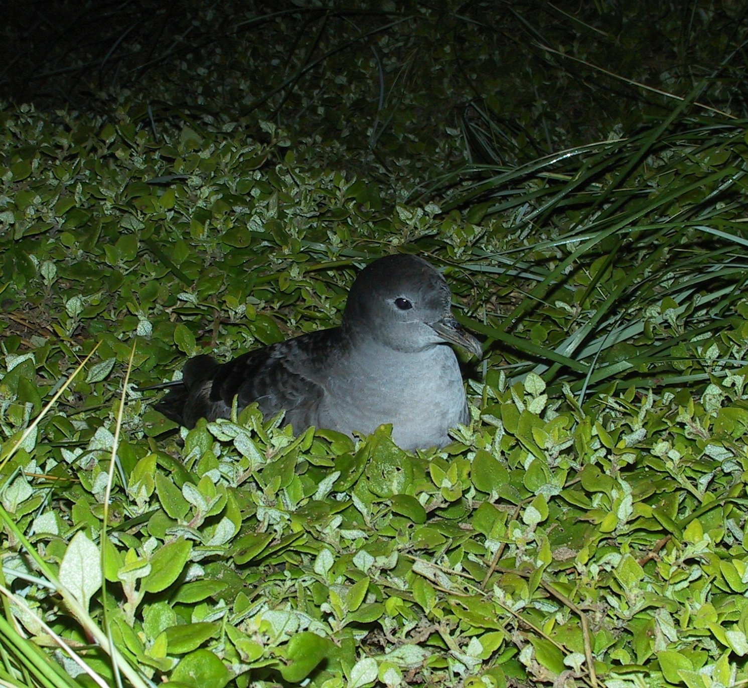
What’s the purpose of this pack?
DEECA encourages key stakeholder groups to promote important information about H5 bird flu.
We would like you to share these materials to ensure everyone remains informed and supported.
How can you help?
Share the materials in this pack with your network via email newsletters, social media and websites.
Image credit: Phillip Island Nature Parks

Slide 3
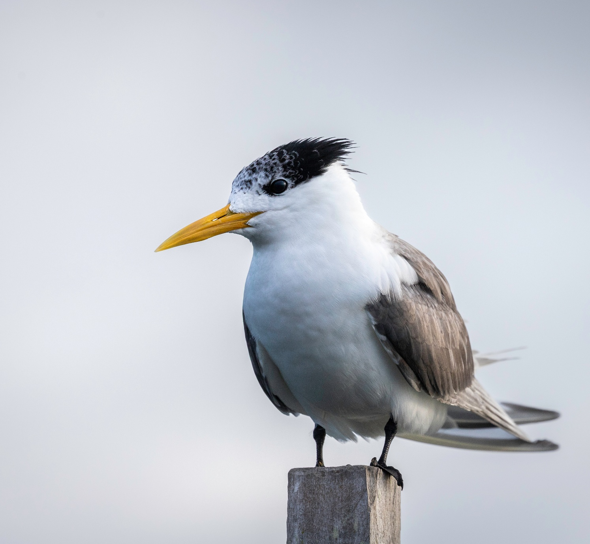
H5 bird flu: current situation
Current situation as of 6 August 2026
H5 bird flu has been confirmed in south-west Victoria.
Cases of H5 bird flu have been confirmed in wild migratory and native seabirds in Western Australia, South Australia, New South Wales, Queensland and Victoria.
There are no detections in poultry.
In line with overseas experience, further spread in wild birds is expected.
The current risk of bird flu to people in Australia is low. Bird flu is not a food safety risk for chicken meat and eggs if they are handled and cooked correctly.
Victorians should stay alert and report sick or dead birds and other wildlife. Do not touch dead wildlife.
Community reports play an important role in Victoria's animal disease surveillance system and support early detection of biosecurity threats.
Nationally agreed arrangements have been activated to support ongoing management and response efforts focused on minimising impacts on wildlife, animal and human health, communities and agricultural industries.

Slide 4
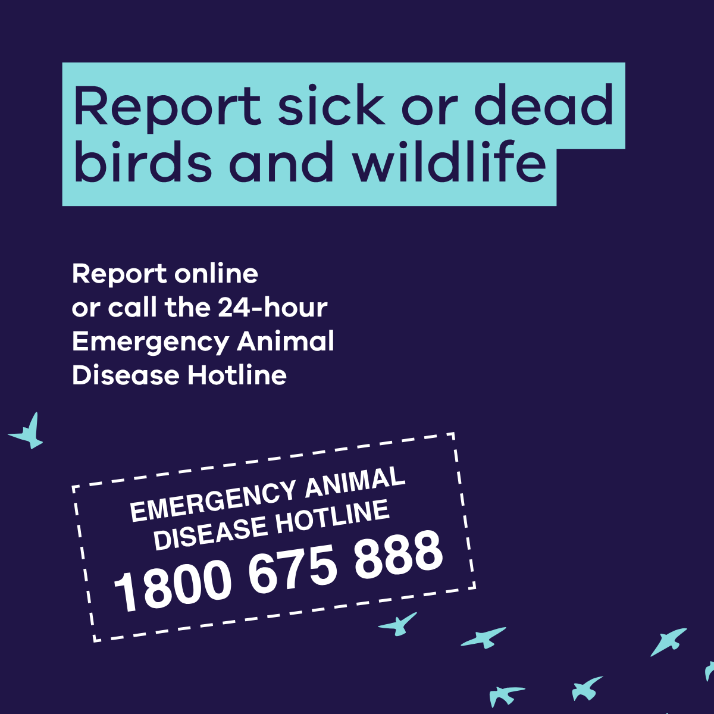
Key messages
What you can do
If you see sick or dead birds or other wildlife, do not touch them.
AVOID contact with sick or dead birds, wildlife or their environment
RECORD what you see and where you saw it.
REPORT it to DEECA using the online form or call the Emergency Animal Disease Hotline on 1800 675 888.
Report clusters of 5 or more sick or dead wildbirds of any species, anywhere in Victoria.
Report even 1 sick or dead:
wild seabird, waterbird, shorebird or bird of prey
marine mammal (e.g. seal, sea lion, dolphin).
Following a report, DEECA will assess each report and decide if testing is needed.
Accurate location information helps us assess reports and respond quickly.
Avoiding contact helps prevent disease spread.
Recording what you see helps experts assess risks and target investigations.
Reporting also helps authorities to identify birds suitable for testing so that emerging disease events are detected as early as possible.
We understand this may be distressing, but every report is useful.
We thank the community for helping protect Victoria’s wildlife.
For the latest updates and more information, visit agriculture.vic.gov.au/birdflu or birdflu.gov.au.

Slide 5
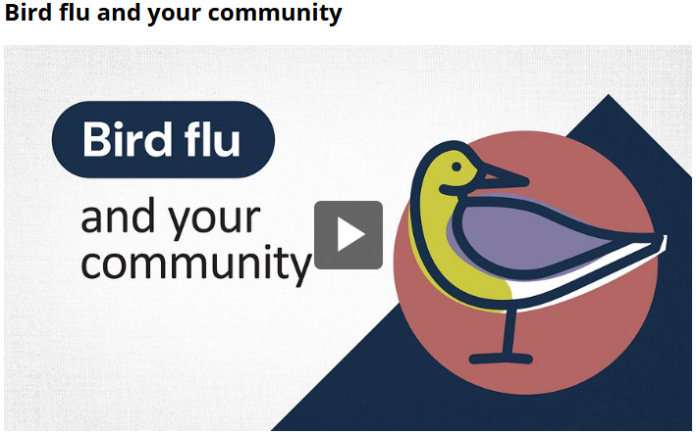
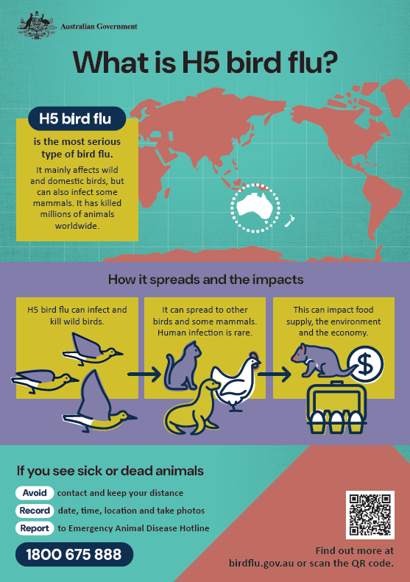
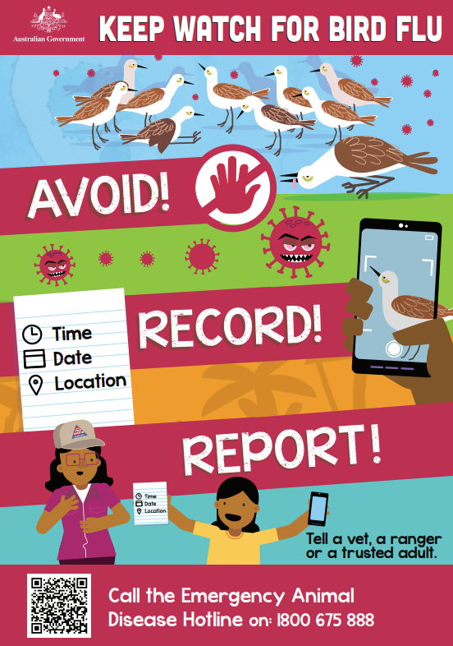
National resources for bird flu
We encourage stakeholders to use and share Australian Government bird flu resources.
Visit: birdflu.gov.au and click on Resources
Link to video
Link to factsheets
Link to First Nations resources

Slide 6
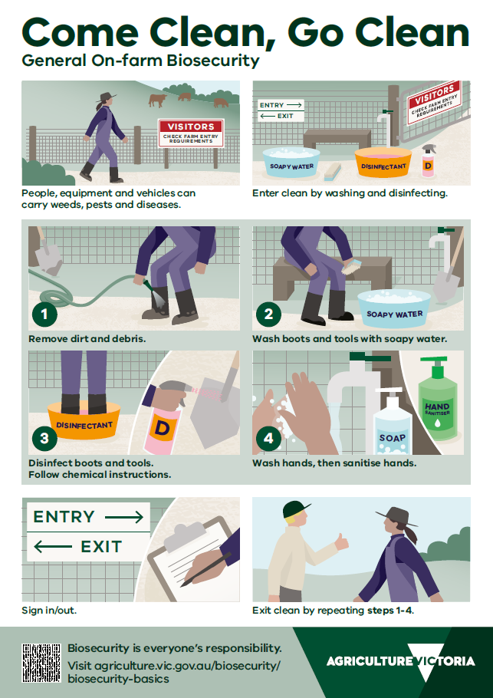
Property biosecurity
Come Clean, Go Clean
Come Clean, Stay Clean, Go Clean – when visiting farms.
On-farm biosecurity is everyone’s responsibility, including the property owner, visitors and workers.
Come clean: planning the visit
Stay clean: entering the property
Go clean: leaving the property
For the latest updates and more information, visit birdflu.gov.au or agriculture.vic.gov.au/birdflu
Link to poster

Slide 7
Managing misinformation
Summary
Misinformation and disinformation are risks during biosecurity emergencies like H5 bird flu.
Misinformation is false of misleading information shared without intent to deceive
Disinformation is false of misleading information shared with the intent to deceive and potentially cause harm.
Both can spread rapidly when uncertainty is high in situations like H5 bird flu. Where there are gaps in information such as an evolving situation, audiences naturally attempt to fill the gaps, increasing the likelihood of speculation. In a social media world – speculation spreads rapidly.
If misinformation or disinformation is developing within your organisation or your audiences – please flag this with sboc.publicinformation@agriculture.vic.gov.au
Proactive approach
Reactive tips
Identify what is uncertain
Anticipate likely assumptions or questions
Design messages and approaches to prevent misunderstanding
Monitor and decide how and when to respond
Learn and adapt
Do
Use materials in this communications pack and other official sources to support coordinated and consistent messaging
Reinforce clear and consistent facts across all channels and materials
Be clear and open about what is known and unknown
Explain the ‘why’ not just the what
Make the message relevant to the audience and provide clear advice on what people can do
Use calm, plain English language
Avoid
Absolute certainty statements where information is still evolving
Creating unnecessary fear or alarm
Over-reassurance that downplays uncertainty or change
Amplifying fringe views or misinformation by repeat or legitimizing them unnecessary
Five step approach
Pre-bunking: Clarify uncertainty and address likely which helps build psychological resistance misunderstandings early.
Uncertainty and sense-making: When information is incomplete or evolving, people rely on prior beliefs and simple, emotionally compelling explanations. Early, clear communication reduces confusion and limits speculative taking hold.
Relevance and agency: audiences disengage when messages lack personal relevance or clear, justifiable action. Providing meaningful context and simple, appropriate actions increases attention, trust and compliance.
Trust, authority and social influence: trusted experts and credible intermediaries increase message acceptance. Coordinated messaging reduces confusion.
Proportionate response: not all misinformation requires direct countering. Over-correction can amplify misinformation. An impact-based, harm-informed approach supports proportionate and effective response decisions.
7

Slide 8
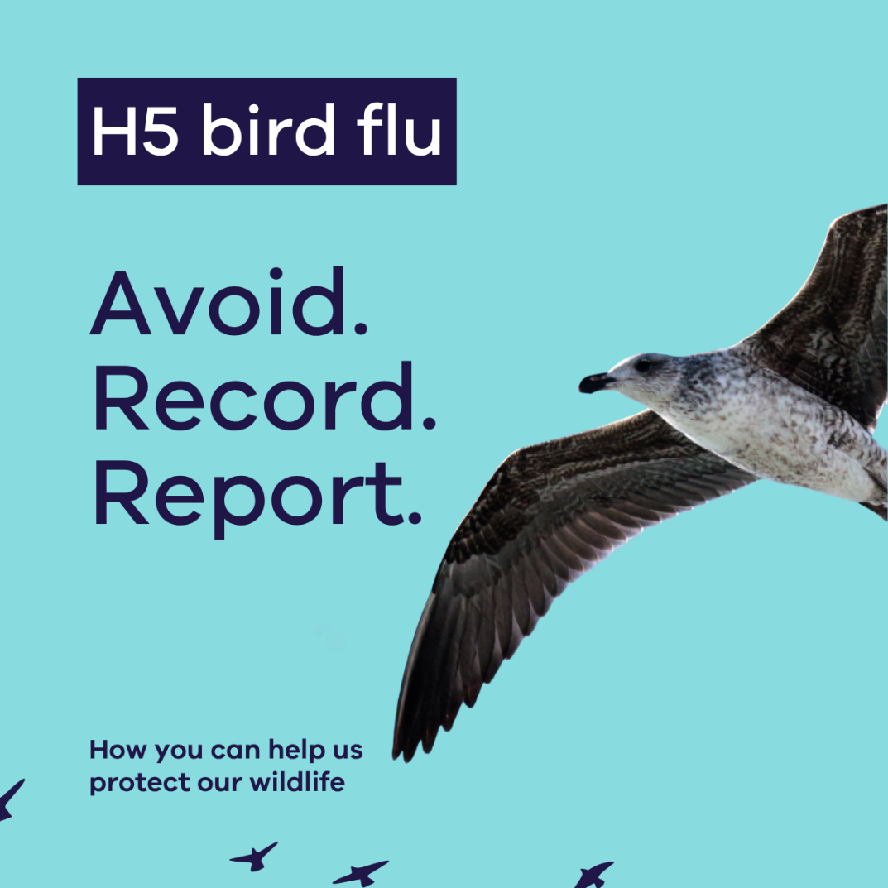
Social media content 1
Suggested copy
H5 bird flu is present in wild birds in south-west Victoria.
Early reporting gives us the best chance to reduce the impacts of the disease.
Avoid. Record. Report. is a simple way you can help.
If you see sick or dead birds or wildlife:
✅ avoid contact
✅ record the exact location and what you observed
✅ report it online or call 1800 675 888
We know people care deeply about wildlife and want to help when they see an animal in distress.
Injured wildlife may still need rescue and care, but if birds or wildlife appear sick, or dead, avoid contact and report it so trained responders can safely assess the situation.
Your report could help detect disease early and support our wildlife.
🔗 agriculture.vic.gov.au/birdflu
Link to social media: https://www.facebook.com/share/p/1Duc9aspdq/
Share on your platforms.
Or you can share an Agriculture Victoria Facebook post

Slide 9
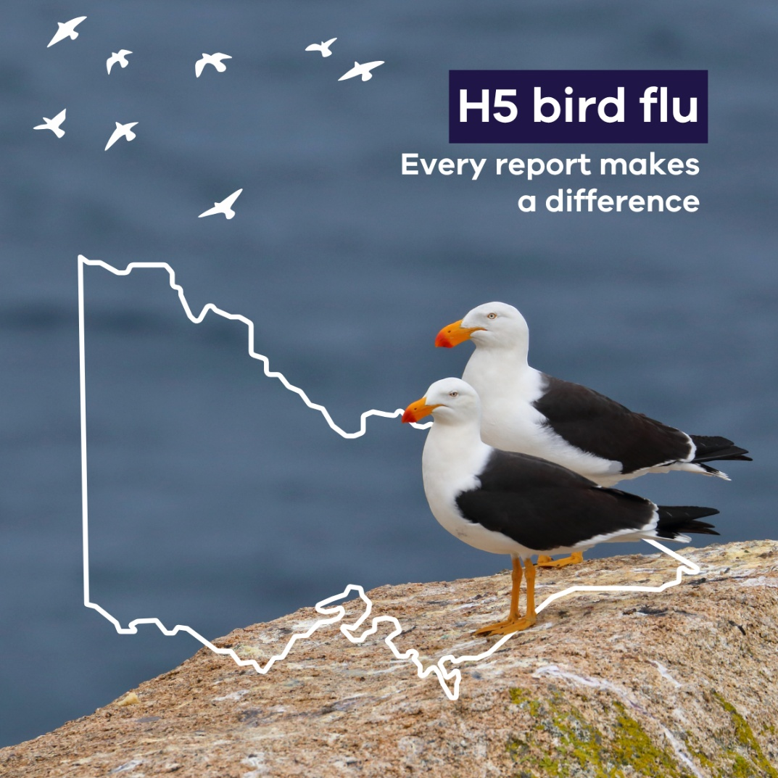
Social media content 2
Suggested copy
Reported sick or dead birds or wildlife? Here's what happens next 👇
H5 bird flu is present in Victoria, and community reports play an important role in helping us detect early and monitor the situation.
Each report DEECA receives is reviewed and assessed using information such as the species, number of birds affected, location and disease risk.
Not all reports will lead to an investigation, collection or testing. Where further action is needed, we may contact you for more information or arrange collection and testing.
If you see sick or dead birds or wildlife, avoid contact, record its exact location and report it online or call 1800 675 888.
You can also view reports on our online map and follow surveillance activity across the state.
Learn more and view the map: 🔗 agriculture.vic.gov.au/birdflu
Link to social media: https://www.facebook.com/share/p/1DS2QTD9jV/
Share on your platforms.
Or you can share an Agriculture Victoria Facebook post

Slide 10
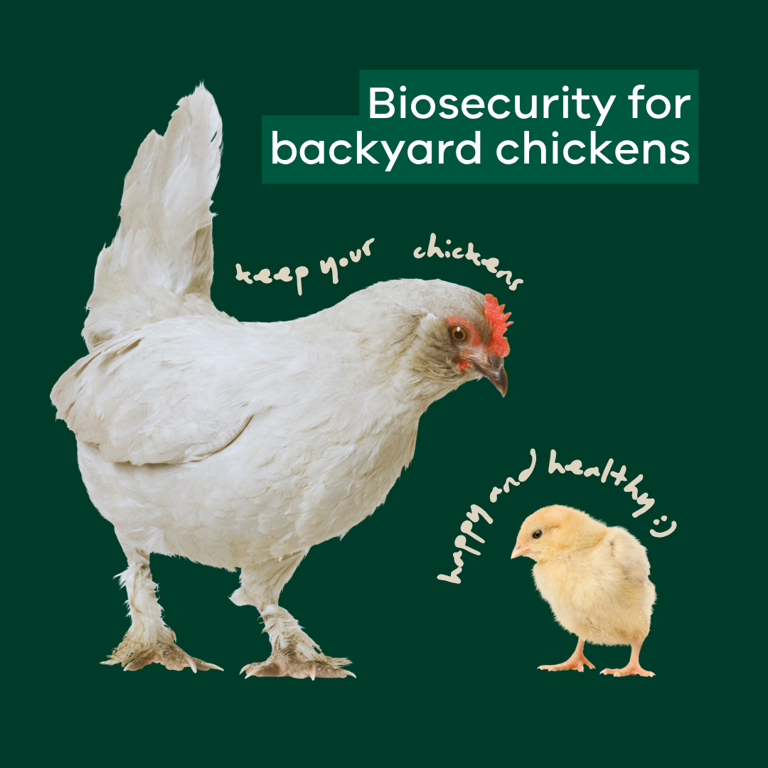
Social media content 3
Suggested copy
Good biosecurity is one of the best ways to protect your chickens.
With H5 bird flu in Victoria, now is a good time to review your setup.
Start with these simple steps.
✅ Keep feed and water away from wild birds
✅ Keep your birds away from dams, ponds and wild bird areas
✅ Use netting, roofing or fencing where practical
✅ Wear clean boots and clothes when entering poultry areas
If you notice something unusual, talk to your local vet or call the
Emergency Animal Disease Hotline on 1800 675 888.
Read more 🔗 go.vic.gov.au/4gNznME
Link to social media: https://www.facebook.com/share/p/1J7nf8mnES/
Share on your platforms.
Or you can share an Agriculture Victoria Facebook post

Slide 11
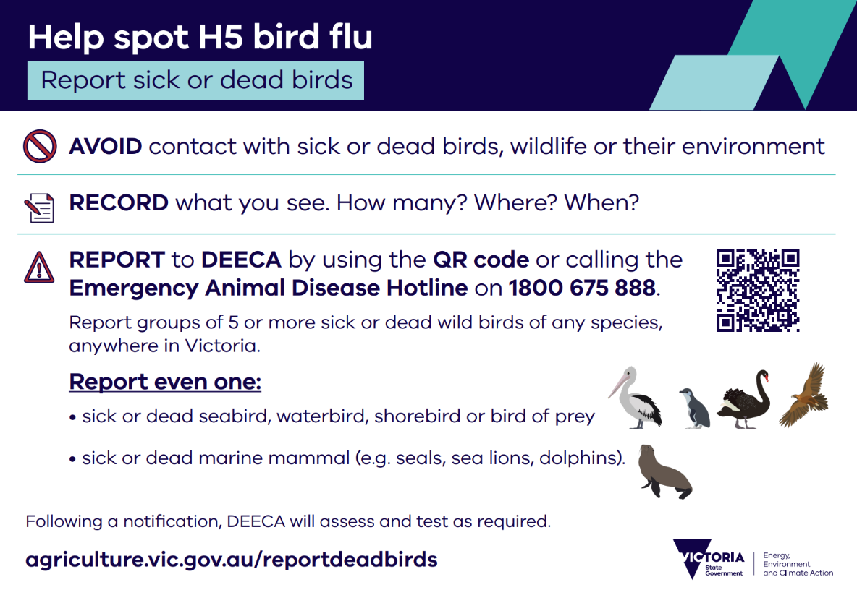
Signage
DEECA is rolling out signage to priority identified areas as part of the incident management approach.
The signage approach complements Victoria’s surveillance strategy, supports community awareness in areas of greatest risk and aims to target priority areas to minimise audience fatigue.
For more information on signage use and recommendations for how it might be appropriate for you, please contact sboc.publicinformation@agriculture.vic.gov.au

Slide 12
Human health risk
  The current risk of H5 bird flu to people in Australia is low
    Human cases of H5N1 are very rare. They usually happen after people have close contact with sick birds or mammals, like livestock.
    It does not spread easily from person to person
  People at higher risk of infection
    People handling infected birds or mammals, such as livestock​
    People who travel to countries with bird flu and have contact with sick birds/other animals
    If you live or work in high-risk places (like poultry farms or if you handle sick animals), take precautions.
  Prevention
    Avoid direct contact with sick or dead birds/other animals, their faeces, and potentially contaminated environments​
    Precautions
    Wear appropriate personal protective equipment (PPE)​ and practice good hygiene
    Adhere to safety directions and training ​
    On-the-job training in PPE and safe practices will be provided​
    Getting your seasonal flu vaccination is strongly recommended. It reduces the risk of becoming seriously ill if you are exposed to both seasonal flu and bird flu at the same time.
    If you have been in contact with sick or dead birds and you develop flu like symptoms, seek medical advice.
  For more information, visit the Australian Centre for Disease Control

Slide 13

H5 bird flu disease links for more information
  Agriculture Victoria H5 bird flu information hub 🔗
Access the latest information about H5 bird flu in Victoria, including current detections, reporting requirements, preparedness activities and guidance for poultry producers, wildlife carers, land managers and the community.
  National information and H5 bird flu resources🔗
  For the latest national updates, preparedness information, reporting guidance and frequently asked questions visit birdflu.gov.au
Wildlife Health Australia 🔗
Information and resource centre for the wildlife community
Human health: Better Health channel 🔗
For information on human health including health risks
Media
Coordinate media activities with sboc.media@agriculture.vic.gov.au

